Slide 1


Overview of HumanFirst Functions Definity

Slide 2
Agenda
What is HumanFirst and Prompt x Data (PxD)?
Overview of Definity’s HumanFirst.ai subscription and support level
How HumanFirst.ai is installed for Definity
Key conceptual flow within HF
Practical Examples
Data in
Prompt
Insights
Pipeline
Classification Model
Data exploration
Visualisation

Slide 3
https://HumanFirst.ai
A horizontal Prompt and Data (PxD) suite for building AI systems you can trust.
LLM Model family agnostic
Google, Anthropic, OpenAi, Co:here…
Work across wide variety of input material
not limited to any one vertical use case or type of data
Pipeline management across large datasets
Keep a data set enriched with derived insight
Prompt and Classifier design
Derive complex structured insight from unstructured data
Reduce the number of classes an LLM provides to a taxonomy meeting your objectives
Maintain and evolve your solution
Expand granularity, cover new business releases, track model drift.

Slide 4
Subscription Overview
5 named users
Write/Admin
Unlimited read only users
fair use
1 million documents stored at any one time.
1 conversation of up to 1000 utterances = 1 document
1 namespace
agreed to raise this to accommodate multi namespaces
Monthly 1h support workshop
Post Deloitte delivery
2 year term expires June 2026

Slide 5
Installation
Cloud based
Dedicated Organisation “definity”
Namespaces can have full data and access segregation
HR v Finance
Prod v Dev
Custom Single Sign on managed by Definity
Users can’t be added through the gui directly
they must be managed in Definity active directory

Slide 6





Conceptual Flow in HF
Calls and Chat Transcripts are regularly loaded into HF forming a dataset
A prompt guides theAI in reading the transcript and following business rules to extract some structured data along with evidence for that decision
Pipeline provides caching and automation to maintain a view of that per-conversation insight across the whole dataset
Classification maps the outputs into a hierarchical taxonomy depending on the intended data use
Cluster
Filter
Explore
Export

Slide 7


SDK or GUI
Full Python SDK for building enterprise workflows https://pypi.org/project/humanfirst/
SDK organised the way the GUI is
Interactively upload your datasets to
explore more insights

Slide 8
Example using Topic report for a conversation Definity

Slide 9
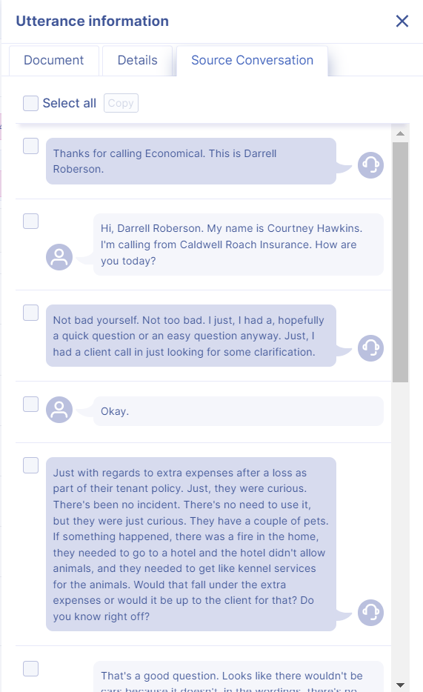
Transcript
Just with regards to extra expenses after a loss as part of their tenant policy. Just, they were curious. There's been no incident. There's no need to use it, but they were just curious. They have a couple of pets. If something happened, there was a fire in the home, they needed to go to a hotel and the hotel didn't allow animals, and they needed to get like kennel services for the animals. Would that fall under the extra expenses or would it be up to the client for that? Do you know right off?
A complex conversation is loaded into HumanFirst
Notes:
600000006093527

Slide 10
Prompt
You are an insurance expert tasked with extracting intents from a conversation transcript…
<conversation>
{{ conversation }}
</conversation
<rules>
- Your task is to list the MAIN issues that the broker expressed to the agent… </rules>
<output_format> Return key-value pairs in the following format:
INTENT: This is a single sentence with a concise summary of the broker request.
REASON: one of the five options listed above that explains why the broker was not able to accomplish the action or resolve the issue on their own through digital channels
JUSTIFICATION: why you chose the reason, based on the information contained within the transcript>
A prompt guiding the AI (simplified)
Notes:
600000006093527

Slide 11
Insight
INTENT | Inquire about coverage for pet kennel expenses under extra expenses after a loss in a tenant policy.
REASON | Legitimate
JUSTIFICATION | The broker's question required specific expertise about policy coverage details that are not explicitly stated in the policy wordings. The agent had to interpret the situation and provide insight based on their knowledge of insurance policies and claims processes.
We get an initial result with the information and justification
The LLM gives very granular classes almost 1 per conversation
Notes:
600000006093527

Slide 12
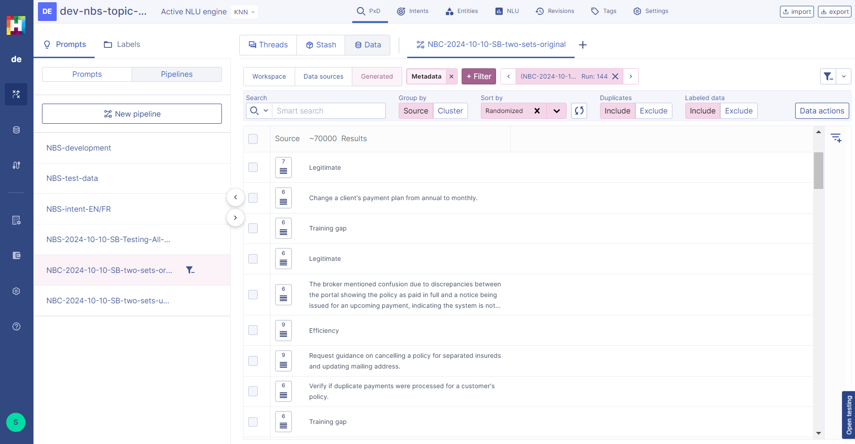
Pipeline
Pipeline caches results, minimising LLM costs
Maintains a view of derived information across whole dataset
Notes:
600000006093527

Slide 13
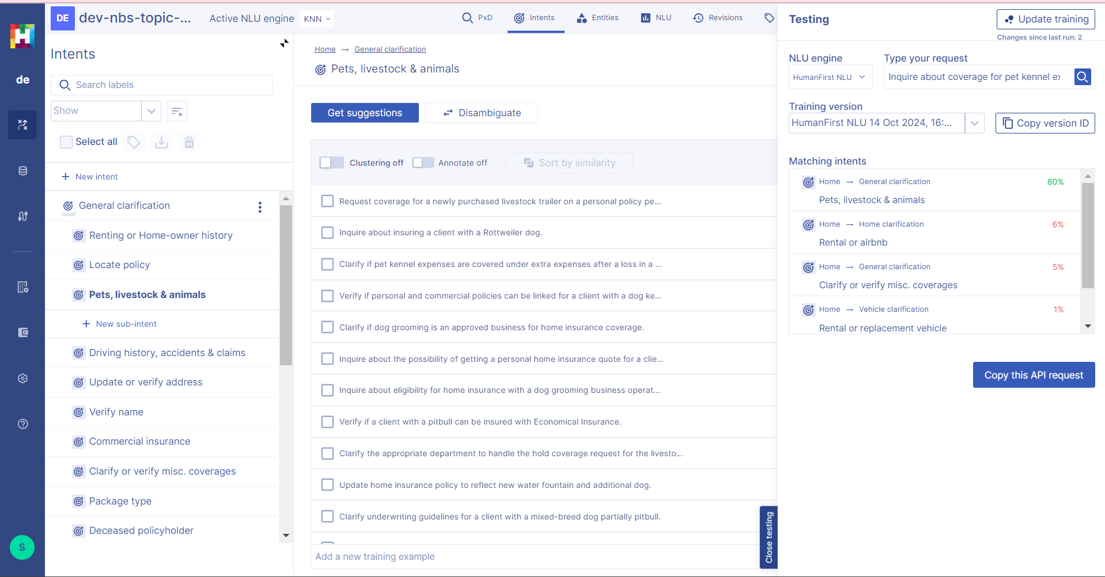
Classification - screenshot
Individual result is mapped onto a business verified two level hierarchy
Notes:
600000006093527

Slide 14
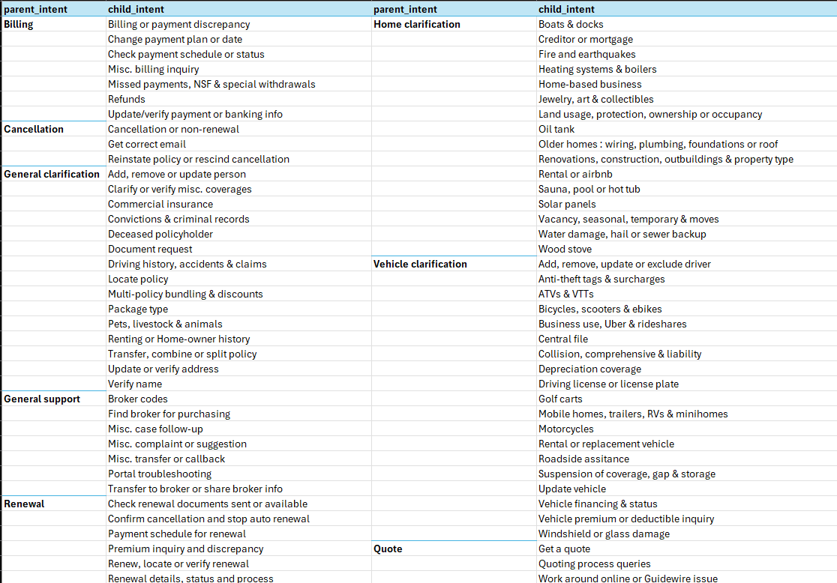
Classification - model summary
Individual result is mapped onto a business verified two level hierarchy ~10 primary classes
~70 sub classes
Notes:
600000006093527

Slide 15
Classification - example
“Inquire about coverage for pet kennel expenses under extra expenses after a loss in a tenant policy.”
General Classification -> Pets, Livestock & animals | 80%
Home Classification -> Rental or airbnb | 6%
General Classification -> Clarify or verify misc. coverages | 5%
Individual result is mapped onto a business verified two level hierarchy
The tool reports the top n (~10) categories. The top category being the most likely is taken when it exceeds a confidence clip
Notes:
600000006093527

Slide 16
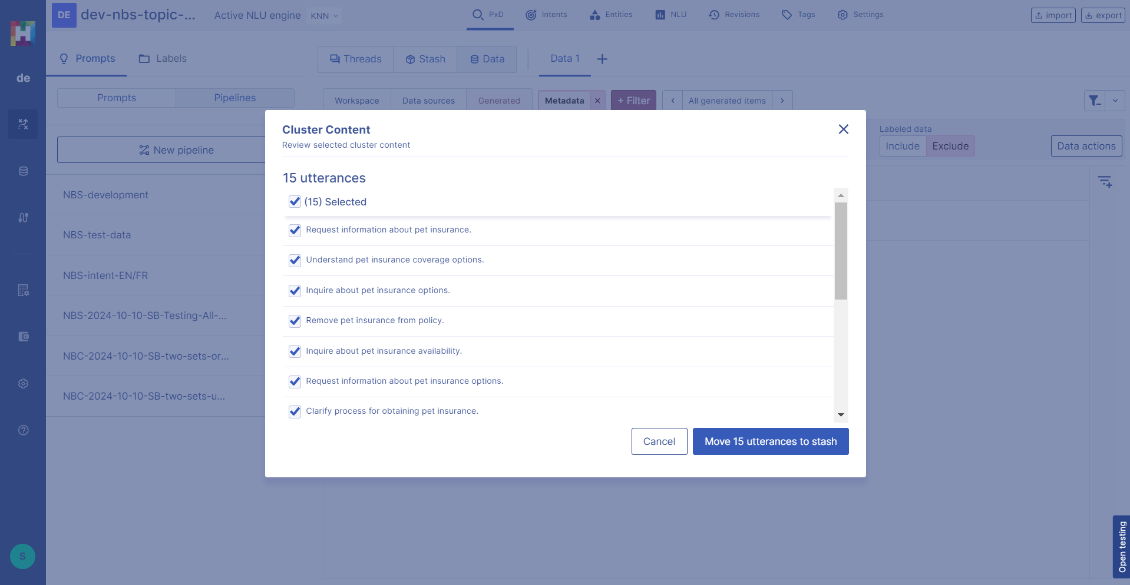
Explore
Cluster
Filter
Explore
Export
Create new models
Answer new questions!
Notes:
600000006093527

Slide 17
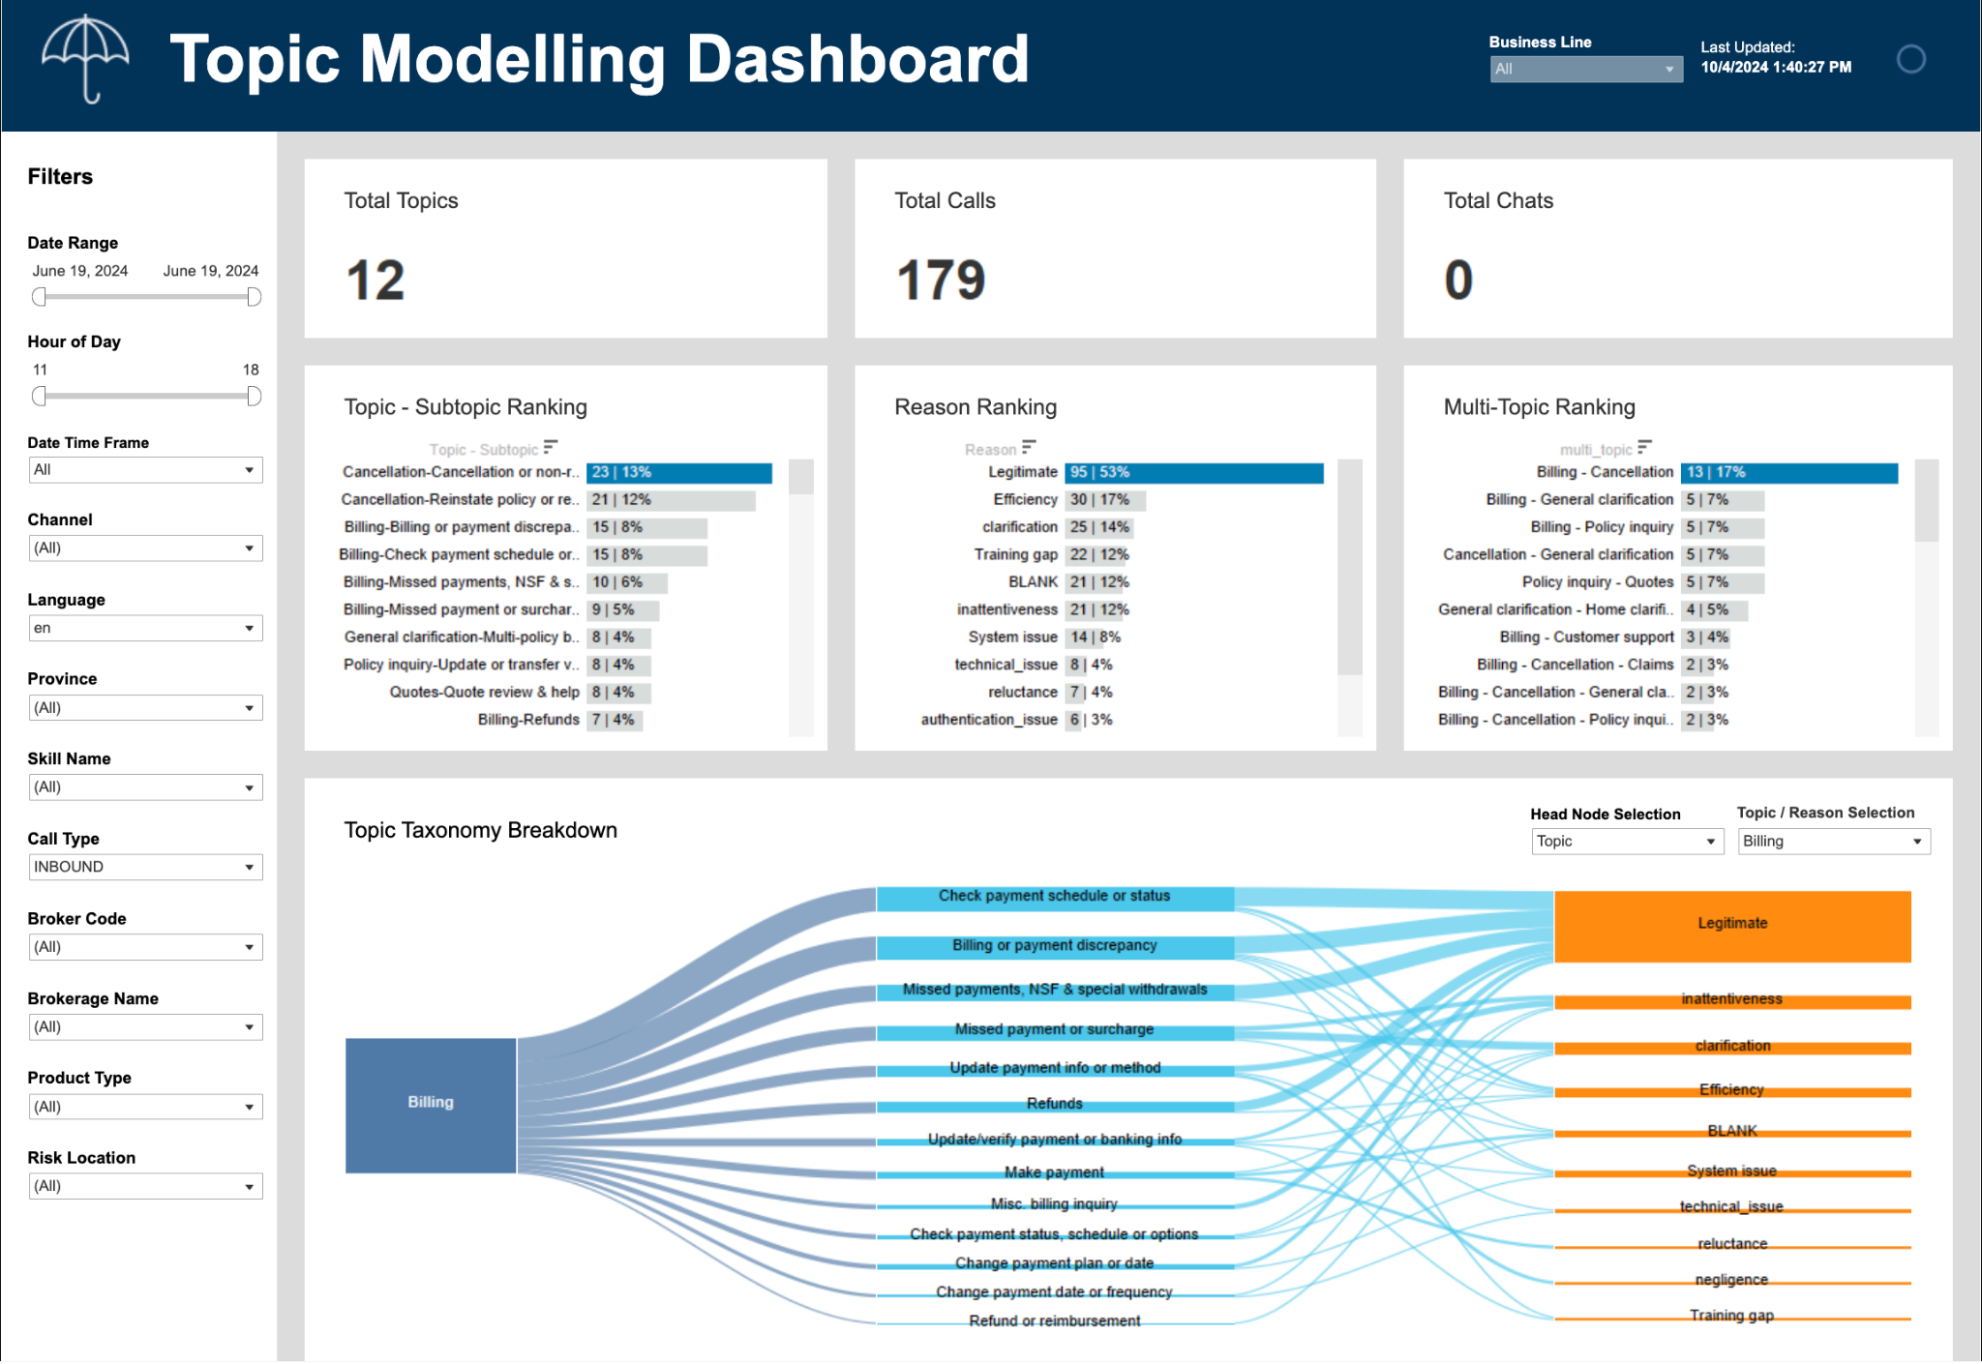
Result
Notes:
600000006093527

Slide 18
Thank you

